Slide 1
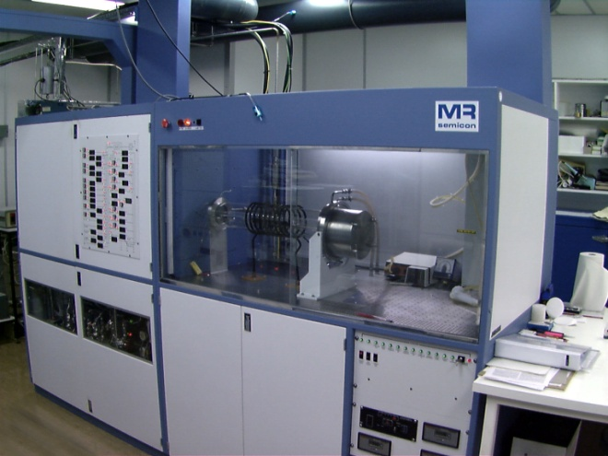
MOVPE
Dr John Roberts

Slide 2
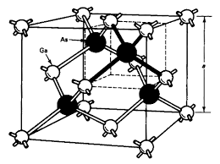
Definition of Terms
MOVPE = Metalorganic Vapour Phase Epitaxy
OMVPE = Organometallic Vapour Phase Epitaxy
MOCVD= Metalorganic Chemical Vapour Deposition, this is the general term for depositing a solid from a vapour and refers to film deposition. The term Epitaxy is more specific and describes the deposit taking the same crystal orientation as the substrate.
The most common substrates are GaAs and InP cut with a (100) surface. The reason for this is technological as the two orthogonal (110) cleavage planes allow cleaving
There are also miscut angles applied to the substrate of usually 2 to 10 degrees from (100) as a way of improving the density of surface reaction sites for the MOVPE process.

Slide 3
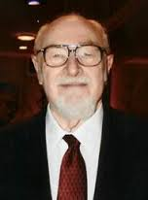
A brief history of this technology
The process was originally demonstrated for GaAs on Sapphire by Harold Manasevit of Rockwell, (Thousand Oaks USA) in about 1967. The work was a continuation of his PhD looking at the decomposition of metal alkyls.
The technique made little progress as other epitaxial techniques were successful, e.g. LPE and VPE using chloride transport. However, MOVPE was able to deposit AlGaAs, unlike the vapour chloride transport epitaxy.
This heterostructure advantage was the key to development in the mid 1970s and used to make semiconductor lasers. (LPE is also used for lasers, but only bulk gain region devices.) In addition, the thickness and doping control provided by MOVPE allowed the development of microwave FETs.
In the UK the device potential of MOVPE was pioneered by Sydney Bass at RSRE Malvern and Ted Thrush at STL labs in Harlow.

Slide 4
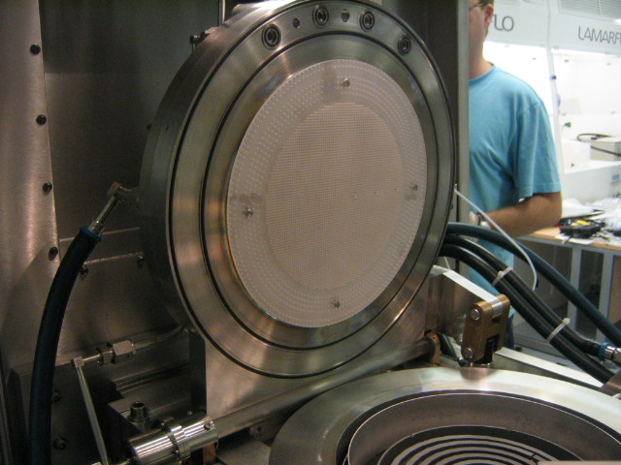
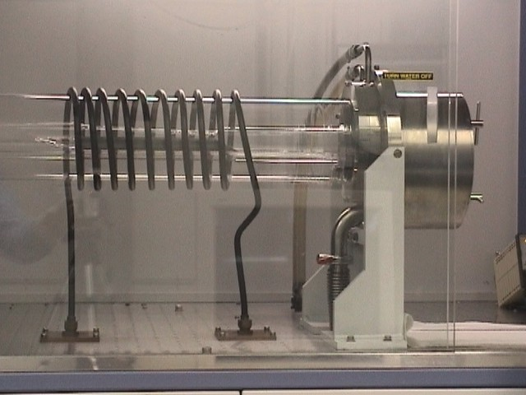
Why is MOVPE important
MOVPE is now the current preferred process for the manufacture of III-V optical devices.
Reactors can be easily scaled from research size to large scale production. The up-time is high and the materials deposited cover a wide range of optoelectronic devices.
The shower-head reactor shown above can be expanded from 6x2 inch substrates to over 100 in a production process
The horizontal quart reactor shown above is more suited to small research quantities.

Slide 5
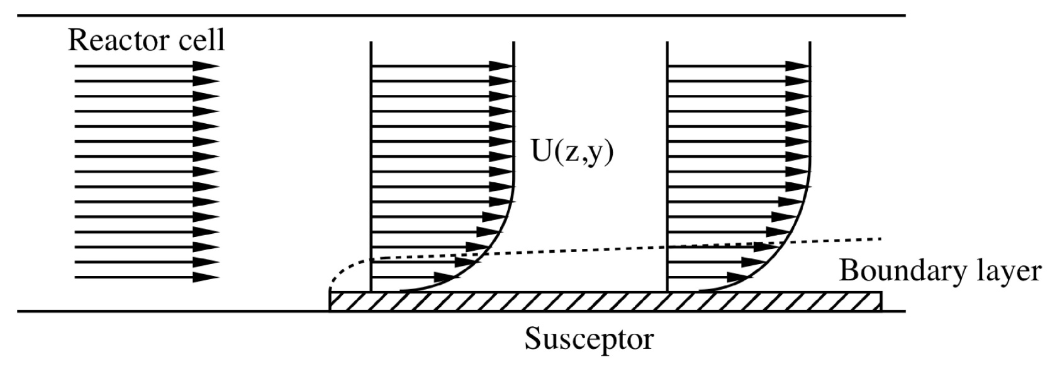
Physical process of growth
The boundary layer model.
The hydrogen velocity above the substrate is close to zero and increases with height. This is simply a consequence of the viscosity of the gas moving with a laminar flow.
Reagents diffusion into the boundary layer and products diffuse out. Any reaction with the surface to produce epitaxial growth is very rapid, so the kinetics are diffusion rate limited. The figure below describes a horizontal flow reactor like the one in the last figure.

Slide 6
MOVPE grown materials
The materials of interest are GaAs and the alloys with the same cubic structure and lattice parameter, primarily AlGaAs and GaInP.
In addition there is extensive technology for InP based materials applied to 1.3/1.55 micron lasers and detectors; viz. fibre communications
The important lattice matched alloys matched to InP are GaInAsP and AlInGaAs.
There is also an extensive use of strained systems such as QWs of GaInAs on GaAs (e.g. pHEMPTs) as well as strain balanced MQWs using GaAsP barriers.(e.g. MQW solar cells)
Red lasers are successful because tensile strained QWs of GaInP can be grown by MOVPE.
MOVPE has been successful because high purity reagents have been developed free of Si, Zn and oxygen in the case of the aluminium precursors. (Adduct Purification developed by Tony Jones at Epichem)
The arsenic and phosphorous hydrides are available with low group four hydride impurities.

Slide 7
Key features of an MOVPE reactor
Hydrogen is supplied to the reactor from a high pressure cylinder source or from an electrolysis process. (Generating hydrogen on demand is inherently safer.)
Hydrogen at 300 psi is purified by diffusing through a Pd/Ag membrane which is very effective for hydrogen. The proton and electron separately diffuse.
The purified gas is then metered into the reactor using “mass flow controllers”. These units deliver a particular PV product ; consequently ,the pressure must be stabilised to deliver a constant volume. The MFC input pressure is 30 psi and the output typically 900 Torr
There is a sample MFC made by MKS to pass round.
Ultra pure hydrogen has two functions; i.e. to provide a carrier gas for the reactor. Secondly, to aid the transfer of reagents from the sources.
The carrier gas sets the operating condition of the reactor and consequently the thickness uniformity of the layers.

Slide 8
Key features of an MOVPE reactor
The vapour from liquid reagents is metered by bubbling with hydrogen.
The source vapour pressure is set by a cooling/heating bath and the hydrogen flow established using a mass flow controller. (MFC). The volume of gas bubbling x the saturated vapour pressure of the reagent defines t he mass transferred and is proportional to growth rate for group III sources.
In every reactor there is a heated susceptor, or carrier, which supports the III-V substrate. This can be RF induction heating if the reactor is silica or resistance heating if the reactor is stainless steel. The temperatures required are up to 750C for GaAs and about 150C lower for InP.
The reactor is normally operated at a lower pressure than atmospheric. A vacuum pump is located at the exhaust of the reactor which is able to pump the hydrogen as well as un-reacted reagents.
A dry pump is the usual technology, i.e. no oil is used to provide a seal.
Typical reactor pressures are 150Torr. Particles of III-V and group V solids need to be collected before the pump. A cooled filter containing activated charcoal can be used.

Slide 9
Key features of an MOVPE reactor
Schematic of an MOVPE

Slide 10
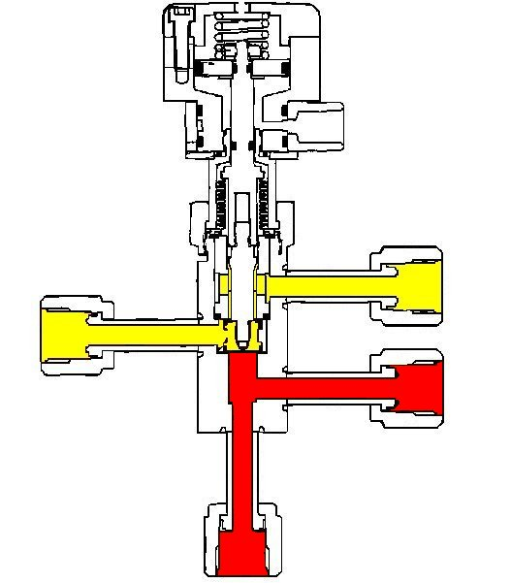
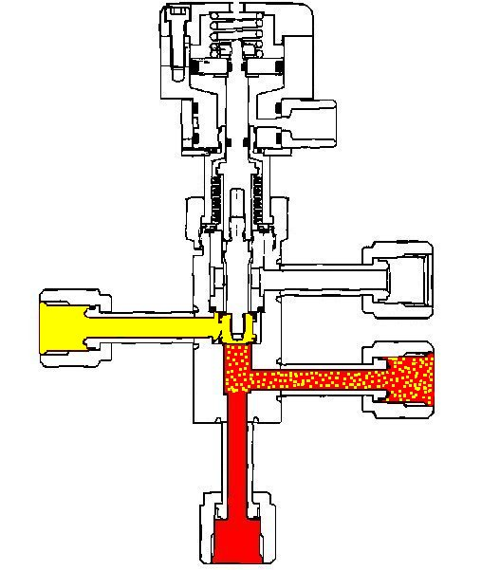
Key features of an MOVPE reactor
The growth process is started by a gas switching arrangement called “vent/run” capable of rapidly adding (and removing) a stable flow of group III reagents in hydrogen.
Prior to growth substrate is heated in the presence of the appropiate group V hydride to remove surface oxides, (which would inhibit epitaxy).
The active hydrogen from arsine and phosphine are effective reducing agents

Slide 11
Key features of an MOVPE reactor
The hydrides of arsine and phosphine do not deposit these elements on the surface of the substrate and are present at some excess concentration before growth ( about 5 to 30 x the group III concentration).
The layer thickness is set by the exposure time to the group III alkyl. This is a linear process with the growth under computer control
The MOVPE reactor is controlling very toxic and inflammable reagents and must have safety circuits to prevent accidental exposure.

Slide 12
Which reagents are used and why?
The MOVPE group III source material must deposit a uniform layer with a practically high growth rate, free from carbon impurities arising from the alkyl group. This ideal precursor is closely met by “ trimethyl” sources.
Also, there should not be an excessive homogeneous gas phase decomposition which would give III-V dust rather than an epitaxial layer.
The methyl group reacts with hydrogen from arsine at the growth surface to produce methane, which can be removed from the reactor.
Hydrogen gas is considered to be essentially unreactive, but has a high thermal conductivity.
The vapour pressures of the group trimethylaluminium, trimethylgallium, and trimethylindium all have a practical values in the 40C to -20C temperature range providing growth rates between 1 and 5 microns/hour.

Slide 13
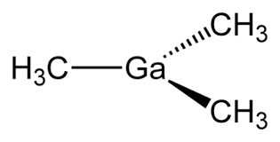
Which reagents are used and why?
Trimetylalumium (TMA) does result in a carbon residue which increases with Al fraction for AlGaAs.
A low growth temperature reduces the carbon content, but aids oxygen inclusion. Very pure TMA, free from the volatile monoalkoxide , is necessary to realise high optical quality and controlled doping.
Trimethylindium is a solid, so the source is sublimed with hydrogen flowing in the opposite direction to a liquid bubbler. Sublimation does not always provide transport of the maximum saturated vapour pressure, so the powder size of the source is critical for a constant/stable output.
Sources for GaAs
TMG:- liquid -5C VP = 51.9 Torr AsH3:- liquid 20C VP = 270 psi

Slide 14
Which reagents are used and why?
The vapour pressure of TMA, TMG and TMI follows the equation:-
Log10 P = A – B/T
T = temperature in degrees K
P is the saturated vapour pressure in Torr
A= 8.07 TMG A=8.22 TMA A=10.52 TMI
B=1703 TMG B=2134 TMA B= 3014 TMI
TMA is a dimer in the gas phase. The liquid freezes at 15C
TMI is supplied a granular solid in a reverse flow bubbler
All these materials spontaneously ignite in air and are supplied in stainless steel
containers with bellows sealed valves.
Purified hydrogen transports the vapour to the reactor
The precursor is never seen and must be identified by in-situ monitors such as
the “Epison”, a vapour concentration measuring system based on Ultra-Sound
Velocity.

Slide 15
Other MOVPE Precursors
u-dimethylhydrazine:
This is a nitrogen source, but very inefficient, toxic and difficult to fully decompose all the
vented material.
Primarily used for GaInAsN alloys having a N fraction of only a few %.
Very low growth temperatures, i.e. below 500C are required, introducing other
problems related to AsH3 decomposition.
t-Butylarsine:
This is a liquid arsenic source transported by hydrogen. The t-butyl group has a weak
bond with arsenic and easily forms AsH2, which decomposes readily to incorporate As.
Ideal for temperature growth, such as nitrides above
bis-methylcylopentadienylmagnesium (a liquid)
The only practical dopant source for Mg and used extensively for GaN p-type doping.
The low diffusion rate of Mg is important for GaInP p-type as an alternative to Zn.
Zn diffusion is a well know problem in opto devices
Bromotrichloromethane;
A liquid carbon doping source for p-type AlGaAs. A very useful reagent made in
response to the banning of CCl4 by the Montreal Protocol. For GaAs there is a low
incorporation sensitivity to growth temperature, unlike CCl4.

Slide 16
Final Comments
MOVPE is a useful process for a wide range of materials, but has limitations related to the available precursors. For example carbon residues in TMA grown AlGaAs. Triethyl based precursors give lower carbon, but are significantly less volatile.
The growth temperature controls all aspects of the process, viz. epitaxy, decomposition of reagents and reactor gas dynamics.
There is a strong influence of thermodynamics, so phase separation can be a problem for certain alloys, such as Sb and GaInAsP matched to GaAs.
The reagents are very reactive and require extensive safety features in the reactor (if it does not poison you it catches fire)
The optical quality and thickness control are now excellent. Quantum Cascade Lasers which demand hundreds of monolayer controlled layers can be grown by MOVPE with good device performance.

